Slide 1

Notes:
Reload codespace
Update settings.json.
Uncheck VS Code tabs except for Terminal
Hide Activity Bar
Hide Explorer
Remove comments from any pre-made code

Slide 2
This is CS5🎃
Visit cs50.ly/screen to view projector on your laptop and ask questions via chat.
Today's snack, Halloween candy! 🍬
Do say hi or ask questions (or ask for stress ball 🔴) during break or after class!

Slide 4
cs50.ly/favorites
Notes:
https://forms.gle/WwxB5tNJQ6uvPjHAA

Slide 5
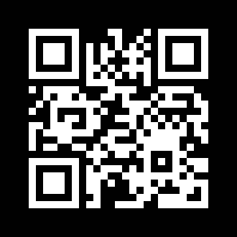

Notes:
https://emojipedia.org/apple/ios-16.4/selfie

Slide 6
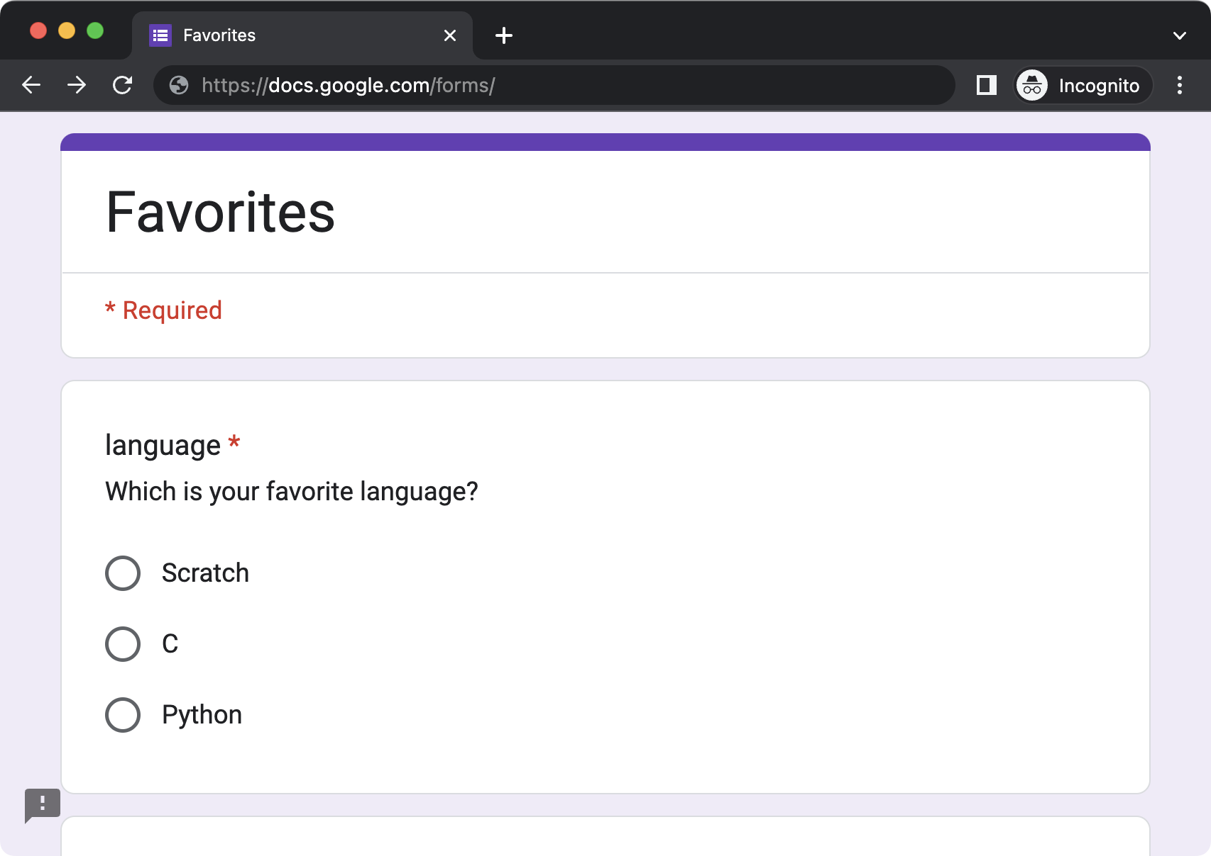

Slide 7
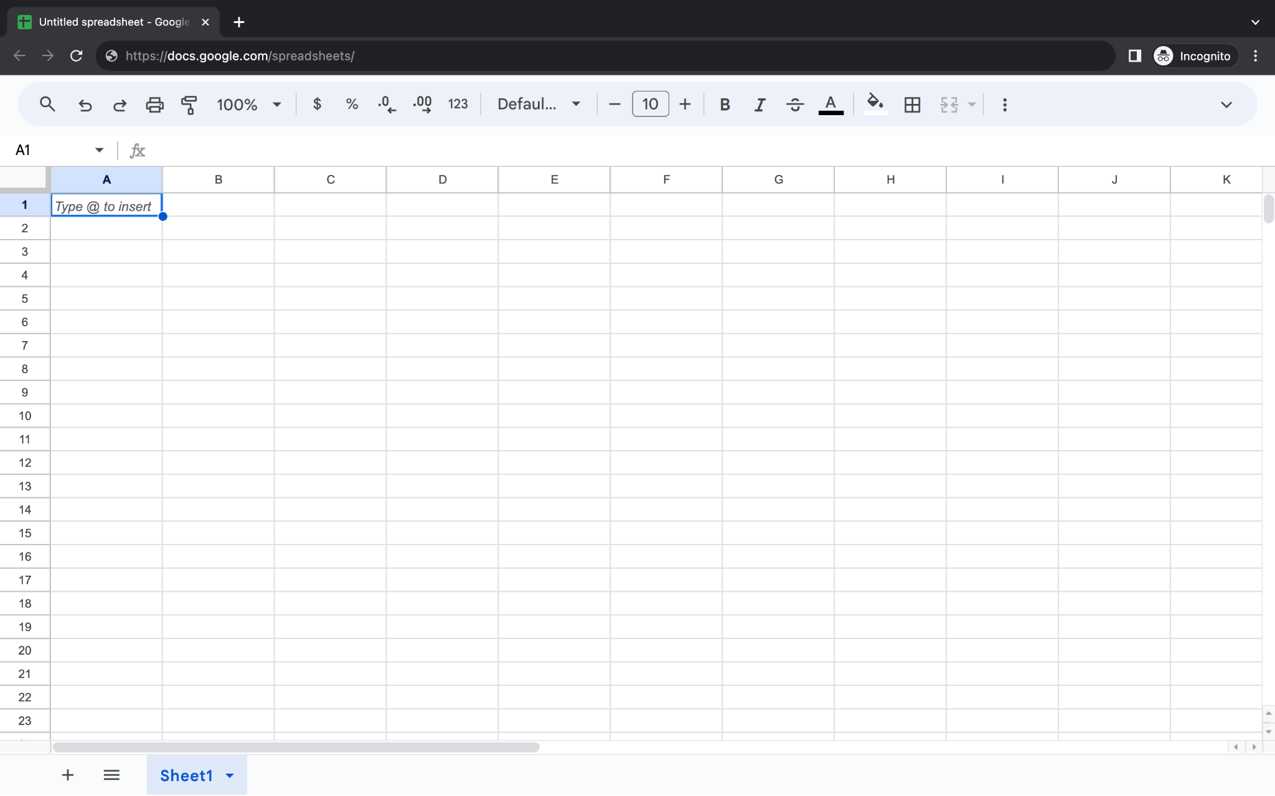
Notes:
https://docs.google.com/spreadsheets/d/1ZZUKOoYqUW3D90tvpVNf3ApxdJ3aQMMeR8ykF0vtZhk/edit?usp=sharing

Slide 8
flat-file database

Slide 9
CSV
Notes:
favorites{0,1,2,3,4}.py

Slide 10
key | value
Notes:
favorites{5,6,7,8,9,10}.py

Slide 11
relational database

Slide 12
SQL

Slide 13
C
R
U
D

Slide 14
CREATE
READ
UPDATE
DELETE

Slide 15
CREATE, INSERT
SELECT
UPDATE
DELETE, DROP
...

Slide 16
CREATE TABLE table (column type, ...);

Slide 17
sqlite3

Slide 18
sqlite3 FILE

Slide 19
.mode csv
.import FILE TABLE
.quit

Slide 20
.schema

Slide 21
SELECT columns FROM table;
...
Notes:
SELECT * FROM favorites;
SELECT language FROM favorites;

Slide 22
AVG
COUNT
DISTINCT
LOWER
MAX
MIN
UPPER
...
Notes:
SELECT COUNT(*) FROM favorites;
SELECT COUNT(language) FROM favorites;
SELECT DISTINCT(language) FROM favorites;
SELECT COUNT(DISTINCT(language)) FROM favorites;

Slide 23
WHERE
LIKE
ORDER BY
LIMIT
GROUP BY
...
Notes:
SELECT COUNT(*) FROM favorites WHERE language = 'C';
SELECT COUNT(*) FROM favorites WHERE language = 'C' AND problem = 'Hello';
SELECT language, COUNT(*) FROM favorites GROUP BY language;
SELECT language, COUNT(*) FROM favorites GROUP BY language ORDER BY COUNT(*) DESC;
SELECT language, COUNT(*) AS n FROM favorites GROUP BY language ORDER BY n DESC;
SELECT language, COUNT(*) AS n FROM favorites GROUP BY language ORDER BY n DESC LIMIT 1;

Slide 24
INSERT INTO table (column, ...) VALUES(value, ...);
Notes:
INSERT INTO favorites (language, problem) VALUES('SQL', 'Fiftyville');
SELECT * FROM favorites;

Slide 25
NULL

Slide 26
DELETE FROM table WHERE condition;
Notes:
DELETE FROM favorites WHERE Timestamp IS NULL;

Slide 27
UPDATE table SET column = value WHERE condition;
Notes:
UPDATE favorites SET language = 'SQL', problem = 'Fiftyville';
SELECT * FROM favorites;
DELETE FROM favorites;
SELECT * FROM favorites;

Slide 28
IMDb
Notes:
https://docs.google.com/spreadsheets/d/1dLh5UqM8LSJzdbdoSo4XOH1tRpBqoSiQBOuAYjYvh2k/edit?usp=sharing
https://docs.google.com/spreadsheets/d/1oOI2ShLC45qOriImskwTs-4mrfX5JaUuqDQe2qf_r-k/edit?usp=sharing
https://docs.google.com/spreadsheets/d/1EMHZDMY0HSH-ybylUxJFhrgqytpq2LlZq99GHOTwVxA/edit?usp=sharing

Slide 29
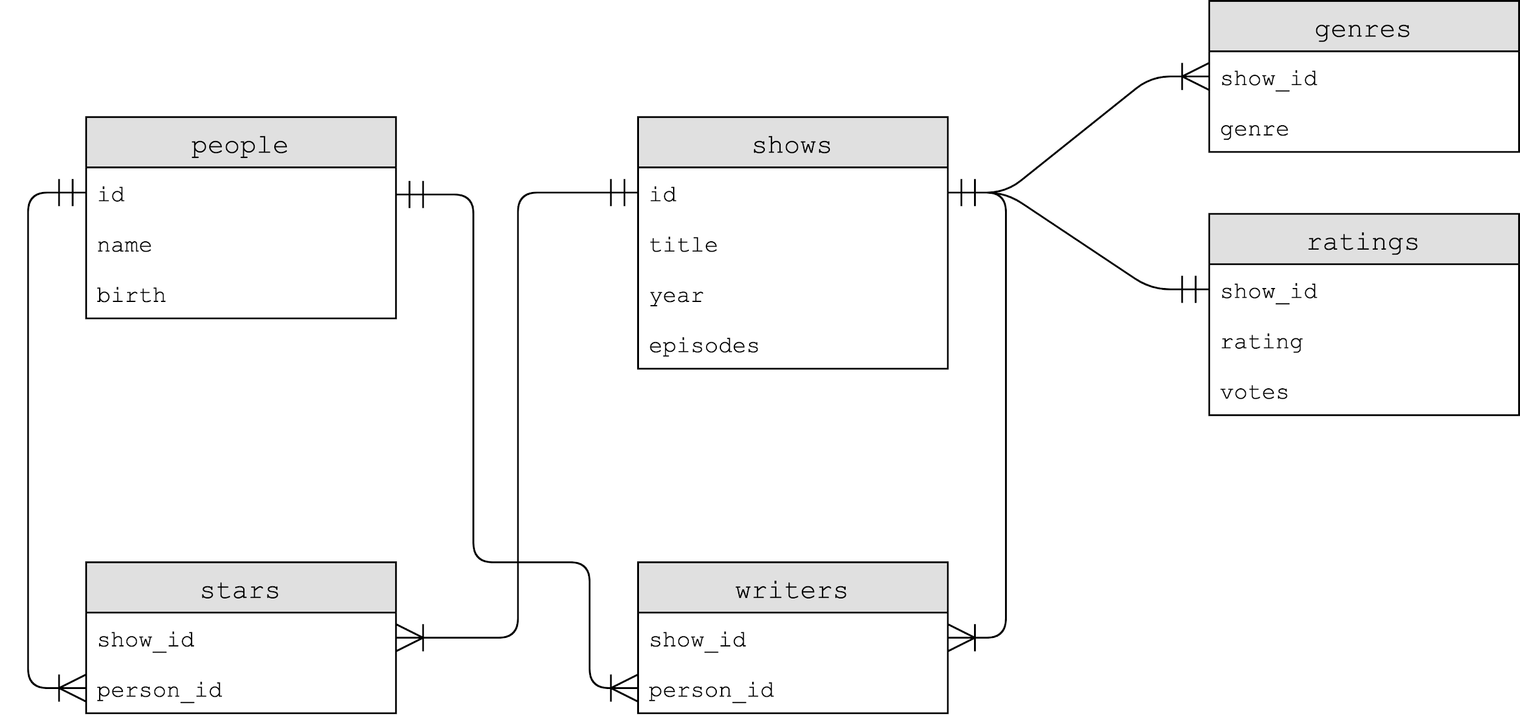

Slide 30
Notes:
SELECT * FROM shows LIMIT 10;
SELECT * FROM ratings LIMIT 10;

Slide 31
one-to-one

Slide 32
Notes:
.schema shows
.schema ratings

Slide 33
BLOB
INTEGER
NUMERIC
REAL
TEXT

Slide 34
NOT NULL
UNIQUE

Slide 35
PRIMARY KEY
FOREIGN KEY
Notes:
SELECT * FROM ratings WHERE rating >= 6.0 LIMIT 10;
SELECT show_id FROM ratings WHERE rating >= 6.0 LIMIT 10;
SELECT * FROM shows WHERE id IN (SELECT show_id FROM ratings WHERE rating >= 6.0) LIMIT 10;
SELECT title FROM shows WHERE id IN (SELECT show_id FROM ratings WHERE rating >= 6.0) LIMIT 10;

Slide 36
JOIN

Slide 37
id | title
386676 | The Office
show_id | rating
386676 | …

Slide 38
title | id
The Office | 386676
show_id | rating
386676 | …

Slide 39
title | id
The Office | 386676
show_id | rating
386676 | …

Slide 40
title | id
The Office | 386676
show_id | rating
386676 | …

Slide 41
title | id
The Office | 386676
rating
…

Slide 42
title
The Office
rating
…
Notes:
SELECT * FROM shows JOIN ratings ON shows.id = ratings.show_id WHERE rating >= 6.0 LIMIT 10;
SELECT title, rating FROM shows JOIN ratings ON shows.id = ratings.show_id WHERE rating >= 6.0 LIMIT 10;

Slide 44
Notes:
SELECT * FROM genres LIMIT 10;
SELECT * FROM shows WHERE id = 63881;

Slide 45
one-to-many
Notes:
.schema genres
SELECT show_id FROM genres WHERE genre = 'Comedy' LIMIT 10;
SELECT title FROM shows WHERE id IN (SELECT show_id FROM genres WHERE genre = 'Comedy') LIMIT 10;
SELECT * FROM genres LIMIT 10;
SELECT genre FROM genres WHERE show_id = 63881;
SELECT genre FROM genres WHERE show_id = (SELECT id FROM shows WHERE title = 'Catweazle');

Slide 46
id | title
63881 | Catweazle
show_id | genre
63881 | Adventure
63881 | Comedy
63881 | Family

Slide 47
title | id
Catweazle | 63881
show_id | genre
63881 | Adventure
63881 | Comedy
63881 | Family

Slide 48
title | id
Catweazle | 63881
show_id | genre
63881 | Adventure
63881 | Comedy
63881 | Family

Slide 49
title | id
Catweazle | 63881
show_id | genre
63881 | Adventure
63881 | Comedy
63881 | Family

Slide 50
title | id
Catweazle | 63881
Catweazle | 63881
Catweazle | 63881
show_id | genre
63881 | Adventure
63881 | Comedy
63881 | Family

Slide 51
title | id
Catweazle | 63881
Catweazle | 63881
Catweazle | 63881
genre
Adventure
Comedy
Family

Slide 52
title
Catweazle
Catweazle
Catweazle
genre
Adventure
Comedy
Family

Slide 53
genre
Adventure
Comedy
Family
Notes:
SELECT * FROM shows JOIN genres ON shows.id = genres.show_id WHERE id = 63881;
SELECT title, genre FROM shows JOIN genres ON shows.id = genres.show_id WHERE id = 63881;
SELECT genre FROM shows JOIN genres ON shows.id = genres.show_id WHERE id = 63881;

Slide 56
many-to-many
Notes:
SELECT name FROM people WHERE id IN
(SELECT person_id FROM stars WHERE show_id =
(SELECT id FROM shows WHERE title = 'The Office' AND year = 2005));
SELECT title FROM shows WHERE id IN
(SELECT show_id FROM stars WHERE person_id =
(SELECT id FROM people WHERE name = 'Steve Carell'));
SELECT title FROM shows
JOIN stars ON shows.id = stars.show_id
JOIN people ON stars.person_id = people.id
WHERE name = 'Steve Carell';
SELECT title FROM shows, stars, people WHERE shows.id = stars.show_id
AND people.id = stars.person_id
AND name = 'Steve Carell';

Slide 57
id | title
386676 | The Office

Slide 58
id | title
386676 | The Office
id | name
136797 | Steve Carell
933988 | Rainn Wilson
1024677 | John Krasinski
278979 | Jenna Fischer
1145983 | B.J. Novak

Slide 59
id | title
386676 | The Office
show_id | person_id
386676 | 136797
386676 | 933988
386676 | 1024677
386676 | 278979
386676 | 1145983
id | name
136797 | Steve Carell
933988 | Rainn Wilson
1024677 | John Krasinski
278979 | Jenna Fischer
1145983 | B.J. Novak

Slide 60
id | title
386676 | The Office
show_id | person_id
386676 | 136797
386676 | 933988
386676 | 1024677
386676 | 278979
386676 | 1145983
id | name
136797 | Steve Carell
933988 | Rainn Wilson
1024677 | John Krasinski
278979 | Jenna Fischer
1145983 | B.J. Novak

Slide 61
id | title
386676 | The Office
show_id | person_id
386676 | 136797
386676 | 933988
386676 | 1024677
386676 | 278979
386676 | 1145983
id | name
136797 | Steve Carell
933988 | Rainn Wilson
1024677 | John Krasinski
278979 | Jenna Fischer
1145983 | B.J. Novak

Slide 62
id | title
386676 | The Office
show_id | person_id
386676 | 136797
386676 | 933988
386676 | 1024677
386676 | 278979
386676 | 1145983
id | name
136797 | Steve Carell
933988 | Rainn Wilson
1024677 | John Krasinski
278979 | Jenna Fischer
1145983 | B.J. Novak

Slide 63
id | title
386676 | The Office
show_id | person_id
386676 | 136797
386676 | 933988
386676 | 1024677
386676 | 278979
386676 | 1145983
id | name
136797 | Steve Carell
933988 | Rainn Wilson
1024677 | John Krasinski
278979 | Jenna Fischer
1145983 | B.J. Novak

Slide 64
id | title
386676 | The Office
show_id | person_id
386676 | 136797
386676 | 933988
386676 | 1024677
386676 | 278979
386676 | 1145983
id | name
136797 | Steve Carell
933988 | Rainn Wilson
1024677 | John Krasinski
278979 | Jenna Fischer
1145983 | B.J. Novak

Slide 65
id | title
386676 | The Office
show_id | person_id
386676 | 136797
386676 | 933988
386676 | 1024677
386676 | 278979
386676 | 1145983
id | name
136797 | Steve Carell
933988 | Rainn Wilson
1024677 | John Krasinski
278979 | Jenna Fischer
1145983 | B.J. Novak

Slide 66
id | title
386676 | The Office
show_id | person_id
386676 | 136797
386676 | 933988
386676 | 1024677
386676 | 278979
386676 | 1145983
name
Steve Carell
Rainn Wilson
John Krasinski
Jenna Fischer
B.J. Novak

Slide 67
id | title
386676 | The Office
show_id | person_id
386676 | 136797
386676 | 933988
386676 | 1024677
386676 | 278979
386676 | 1145983
name
Steve Carell
Rainn Wilson
John Krasinski
Jenna Fischer
B.J. Novak

Slide 68
title | id
The Office | 386676
show_id | person_id
386676 | 136797
386676 | 933988
386676 | 1024677
386676 | 278979
386676 | 1145983
name
Steve Carell
Rainn Wilson
John Krasinski
Jenna Fischer
B.J. Novak

Slide 69
title | id
The Office | 386676
show_id | person_id
386676 | 136797
386676 | 933988
386676 | 1024677
386676 | 278979
386676 | 1145983
name
Steve Carell
Rainn Wilson
John Krasinski
Jenna Fischer
B.J. Novak

Slide 70
title | id
The Office | 386676
show_id | person_id
386676 | 136797
386676 | 933988
386676 | 1024677
386676 | 278979
386676 | 1145983
name
Steve Carell
Rainn Wilson
John Krasinski
Jenna Fischer
B.J. Novak

Slide 71
title | id
The Office | 386676
The Office | 386676
The Office | 386676
The Office | 386676
The Office | 386676
show_id | person_id
386676 | 136797
386676 | 933988
386676 | 1024677
386676 | 278979
386676 | 1145983
name
Steve Carell
Rainn Wilson
John Krasinski
Jenna Fischer
B.J. Novak

Slide 72
title
The Office
The Office
The Office
The Office
The Office
show_id | person_id
386676 | 136797
386676 | 933988
386676 | 1024677
386676 | 278979
386676 | 1145983
name
Steve Carell
Rainn Wilson
John Krasinski
Jenna Fischer
B.J. Novak

Slide 73
title
The Office
The Office
The Office
The Office
The Office
person_id
136797
933988
1024677
278979
1145983
name
Steve Carell
Rainn Wilson
John Krasinski
Jenna Fischer
B.J. Novak

Slide 74
title
The Office
The Office
The Office
The Office
The Office
name
Steve Carell
Rainn Wilson
John Krasinski
Jenna Fischer
B.J. Novak

Slide 75
name
Steve Carell
Rainn Wilson
John Krasinski
Jenna Fischer
B.J. Novak

Slide 76
Notes:
.schema writers

Slide 77
indexes
Notes:
.timer ON
SELECT * FROM shows WHERE title = 'The Office';

Slide 78
CREATE INDEX name ON table (column, ...);
Notes:
CREATE INDEX title_index ON shows (title);
SELECT * FROM shows WHERE title = 'The Office';

Slide 79
B-trees

Slide 80
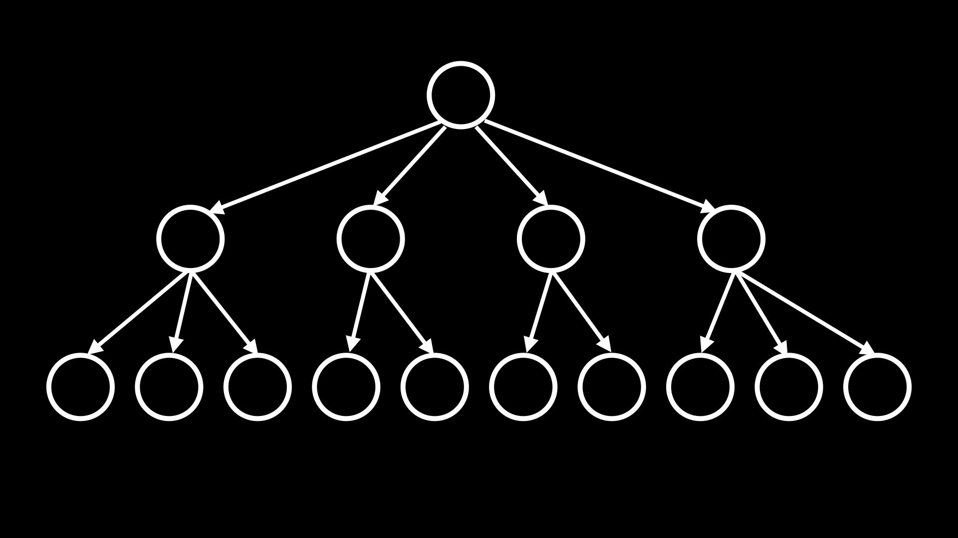
Notes:
SELECT title FROM shows, stars, people
WHERE shows.id = stars.show_id
AND people.id = stars.person_id
AND name = 'Steve Carell';
CREATE INDEX person_index ON stars (person_id);
CREATE INDEX show_index ON stars (show_id);
CREATE INDEX name_index ON people (name);
SELECT title FROM shows, stars, people
WHERE shows.id = stars.show_id
AND people.id = stars.person_id
AND name = 'Steve Carell';

Slide 81
from cs50 import SQL

Slide 82
cs50.readthedocs.io/libraries/cs50/python/#cs50.SQL
Notes:
favorites11.py

Slide 83
race conditions

Slide 84
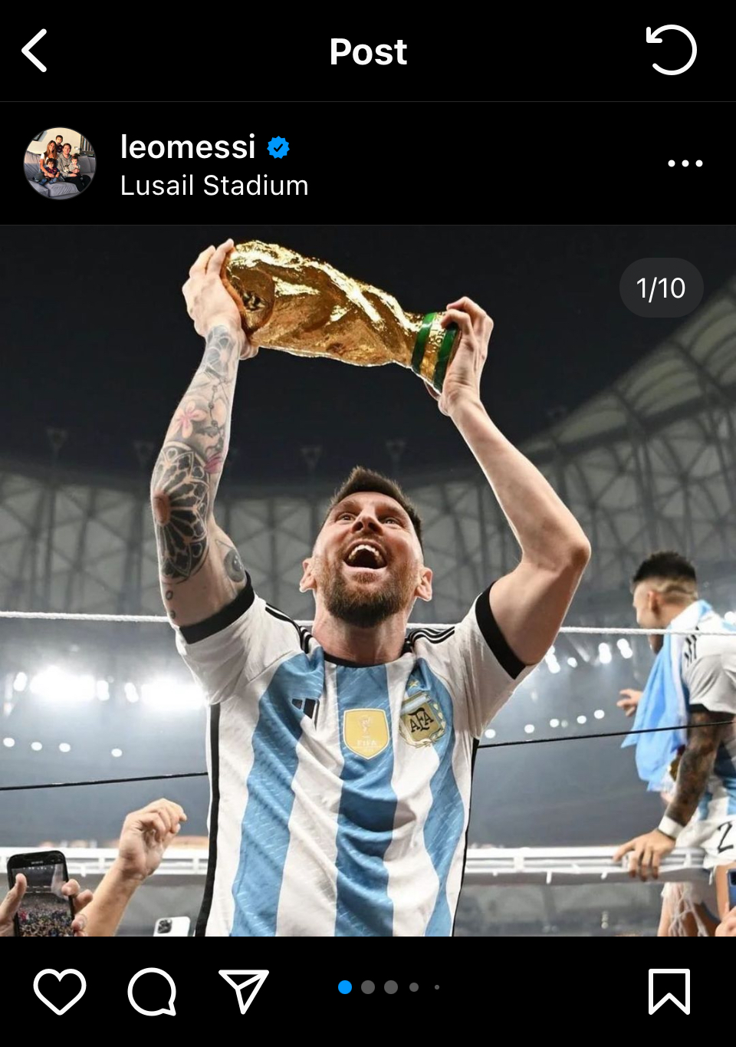
Notes:
https://www.instagram.com/p/CmUv48DLvxd/

Slide 85
rows = db.execute("SELECT likes FROM posts WHERE id = ?", id);
likes = rows[0]["likes"]
db.execute("UPDATE posts SET likes = ? WHERE id = ?", likes + 1, id);

Slide 86
rows = db.execute("SELECT likes FROM posts WHERE id = ?", id);
likes = rows[0]["likes"]
db.execute("UPDATE posts SET likes = ? WHERE id = ?", likes + 1, id);

Slide 87
BEGIN TRANSACTION
COMMIT
ROLLBACK

Slide 88
db.execute("BEGIN TRANSACTION")
rows = db.execute("SELECT likes FROM posts WHERE id = ?", id);
likes = rows[0]["likes"]
db.execute("UPDATE posts SET likes = ? WHERE id = ?", likes + 1, id);
db.execute("COMMIT")

Slide 89
SQL injection attacks

Slide 90
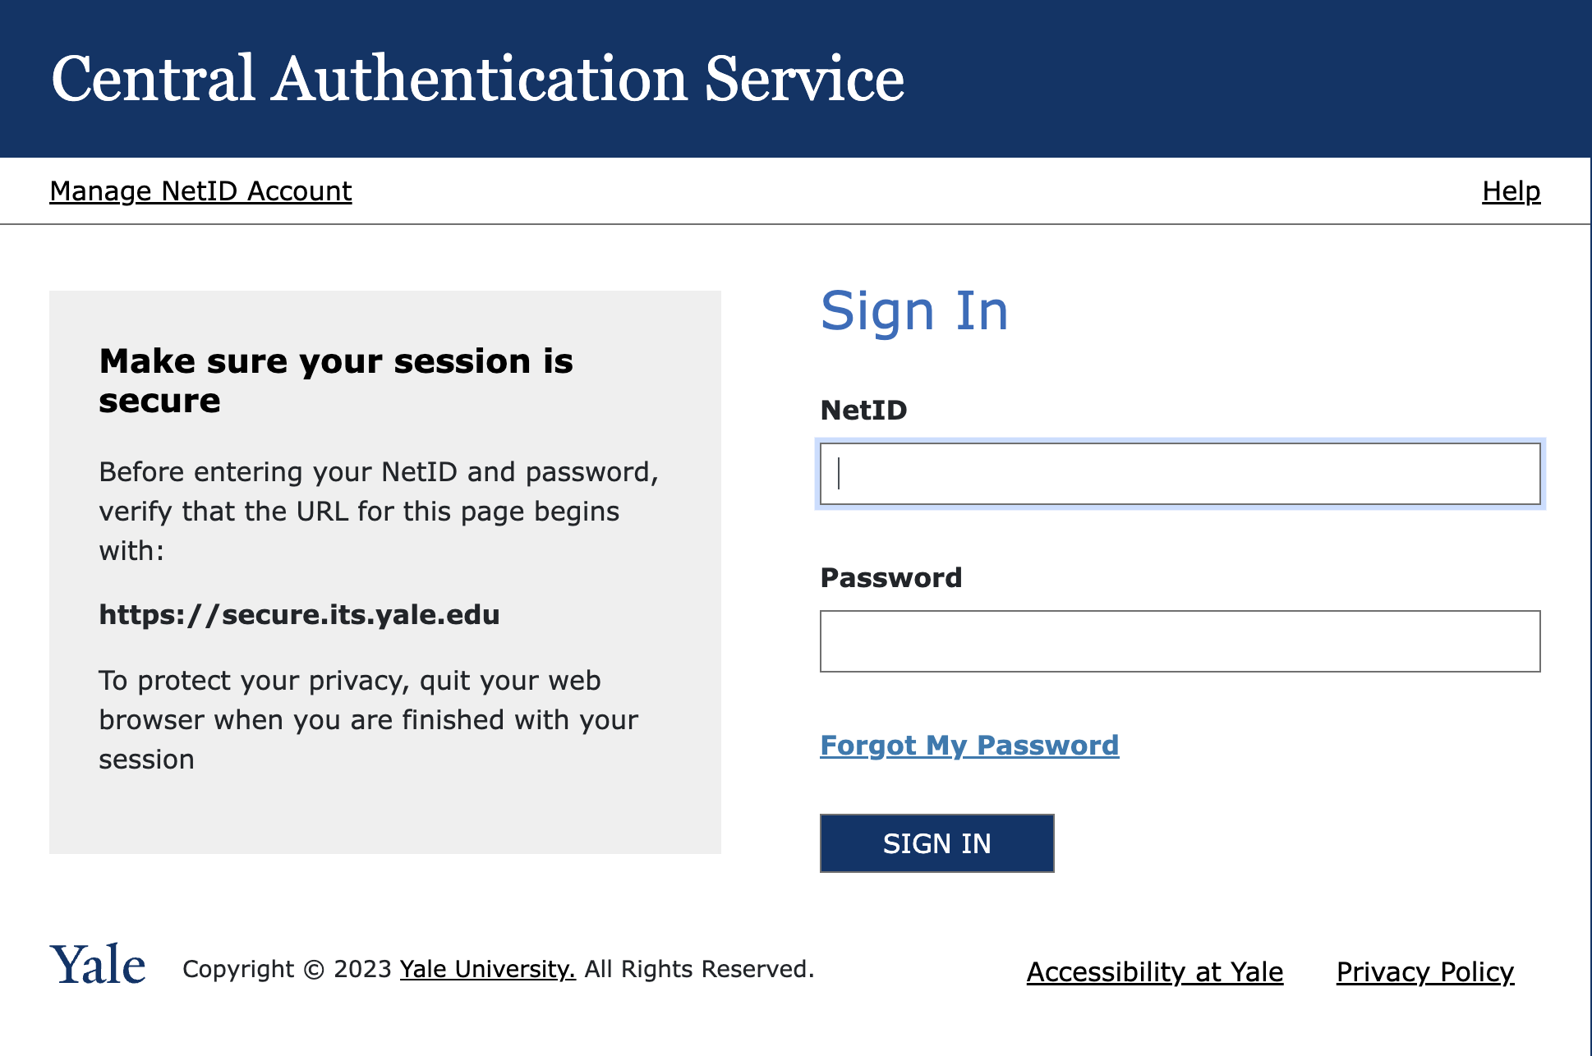

Slide 91
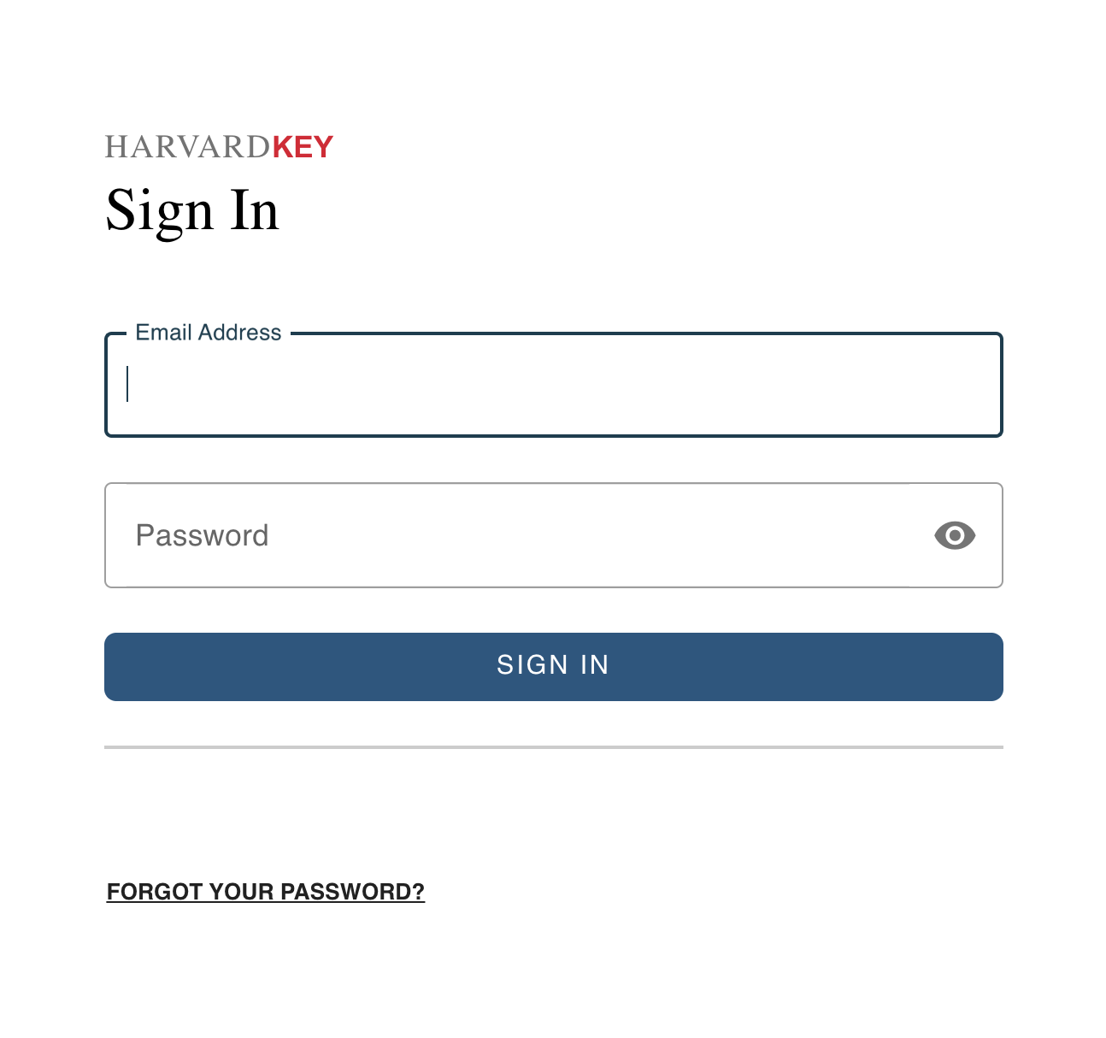

Slide 92
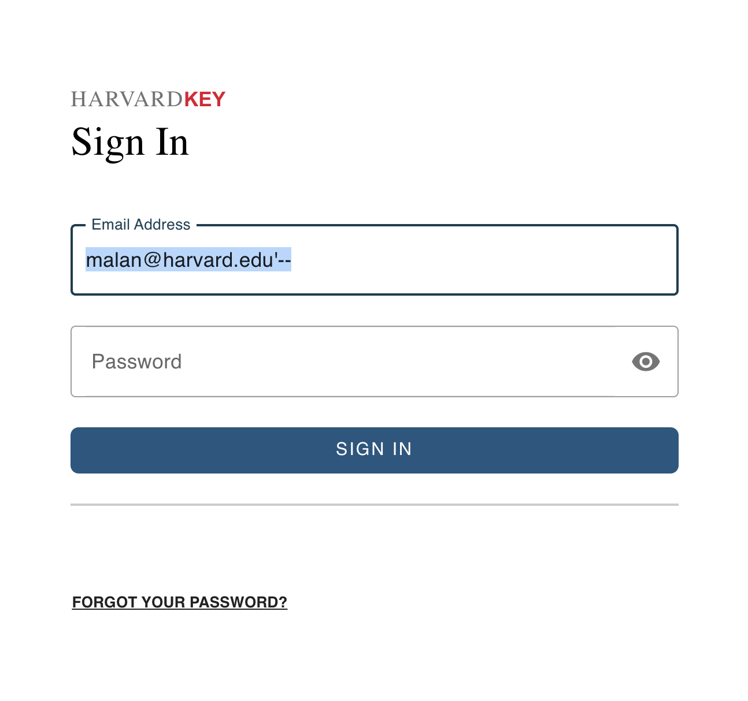

Slide 93
rows = db.execute("SELECT * FROM users WHERE username = ? AND password = ?", username, password)
if rows:
...

Slide 94
rows = db.execute("SELECT * FROM users WHERE username = ? AND password = ?", username, password)
if rows:
...

Slide 95
rows = db.execute("SELECT * FROM users WHERE username = ? AND password = ?", username, password)
if rows:
...

Slide 96
rows = db.execute(f"SELECT * FROM users WHERE username = '{username}' AND password = '{password}'")
if rows:
...

Slide 97
rows = db.execute(f"SELECT * FROM users WHERE username = '{username}' AND password = '{password}'")
if rows:
...

Slide 98
rows = db.execute(f"SELECT * FROM users WHERE username = 'malan@harvard.edu'--' AND password = '{password}'")
if rows:
...

Slide 99
rows = db.execute(f"SELECT * FROM users WHERE username = 'malan@harvard.edu'--' AND password = '{password}'")
if rows:
...

Slide 100
rows = db.execute(f"SELECT * FROM users WHERE username = 'malan@harvard.edu''--' AND password = '{password}'")
if rows:
...

Slide 101
rows = db.execute("SELECT * FROM users WHERE username = ? AND password = ?", username, password)
if rows:
...

Slide 102
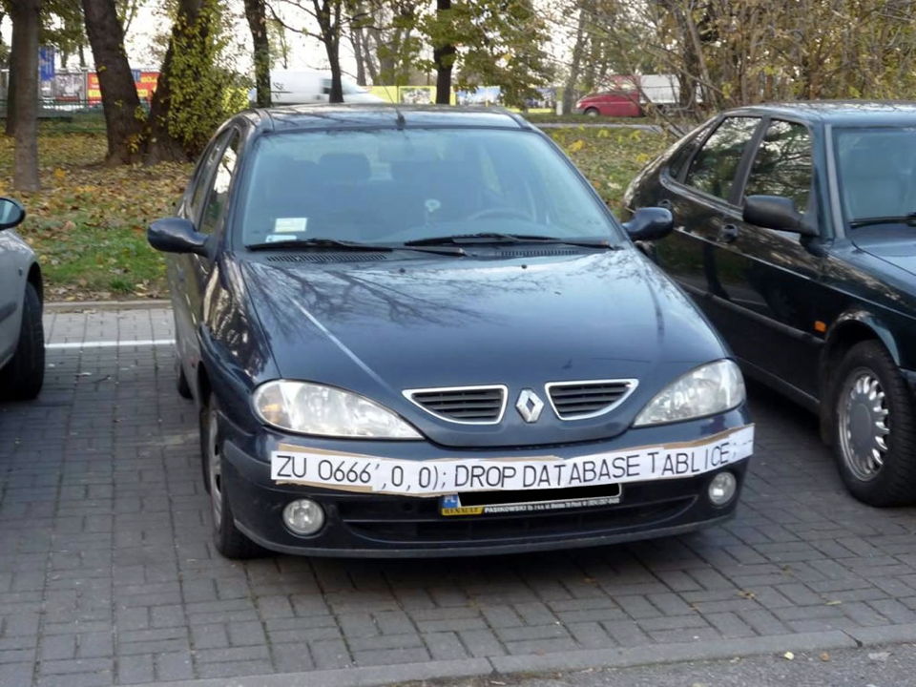

Slide 103
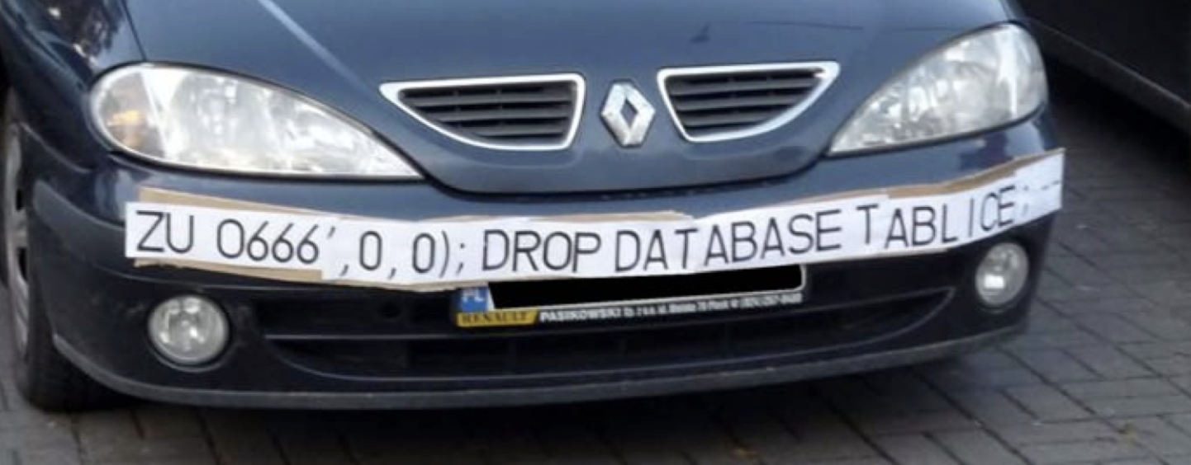

Slide 104

Notes:
https://xkcd.com/327/

